Slide 1
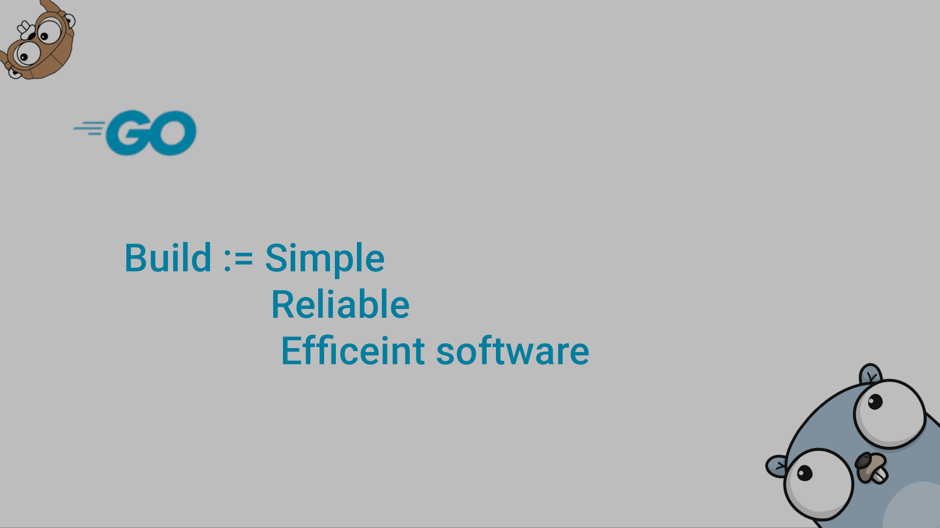
Go Streams & DataBase

Slide 2
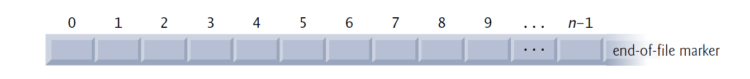
What Are Files?
Programming languages, view file simply as a sequential stream of bytes (Array of bytes).
Each file ends either with an end-of-file marker or at a specific byte number recorded in a system-maintained, administrative data structure.
File/Stream
Three streams are automatically opened when program execution begins:
the standard input (which receives input from the keyboard),
the standard output (which displays output on the screen) and
the standard error (which displays error messages on the screen)
When a file is opened, a stream is associated with it, which in turn provides communication channels between files and programs.

Slide 3
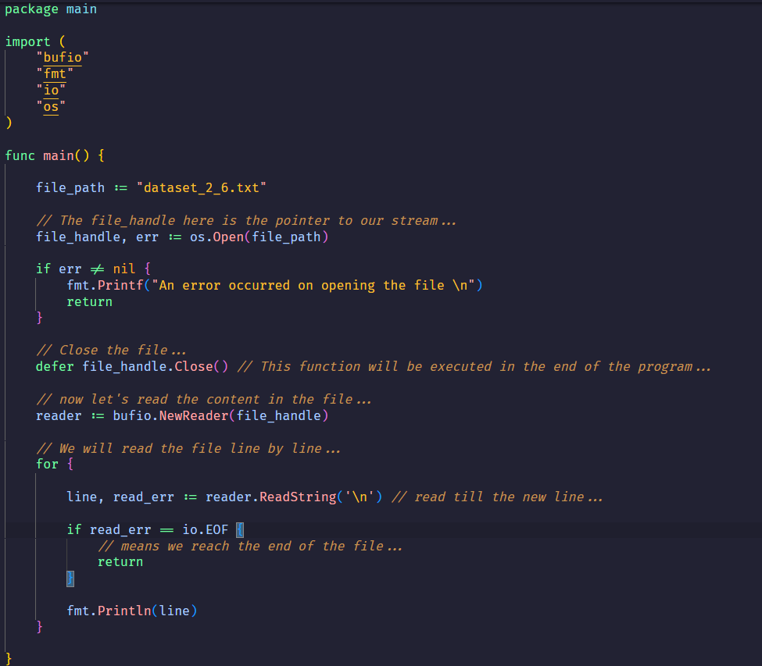
The Go Files (Open files and read line by line):

Slide 4
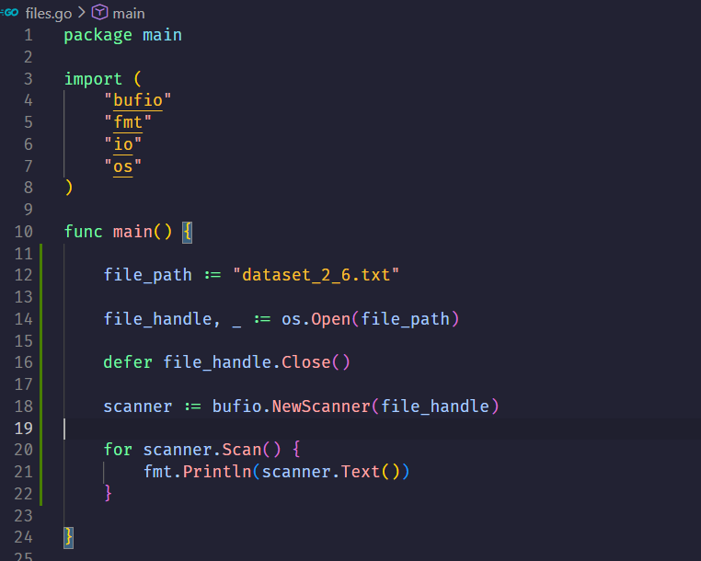
The Go Files (Open files and read line by line):

Slide 5
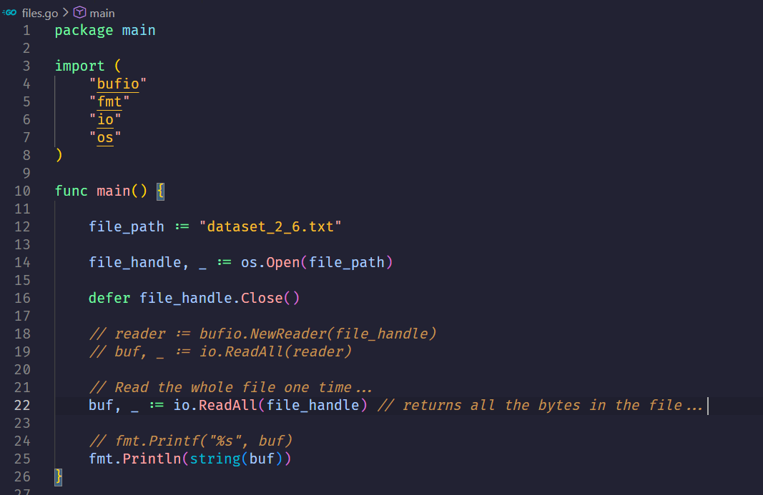
The Go Files (read the whole content one time):

Slide 6
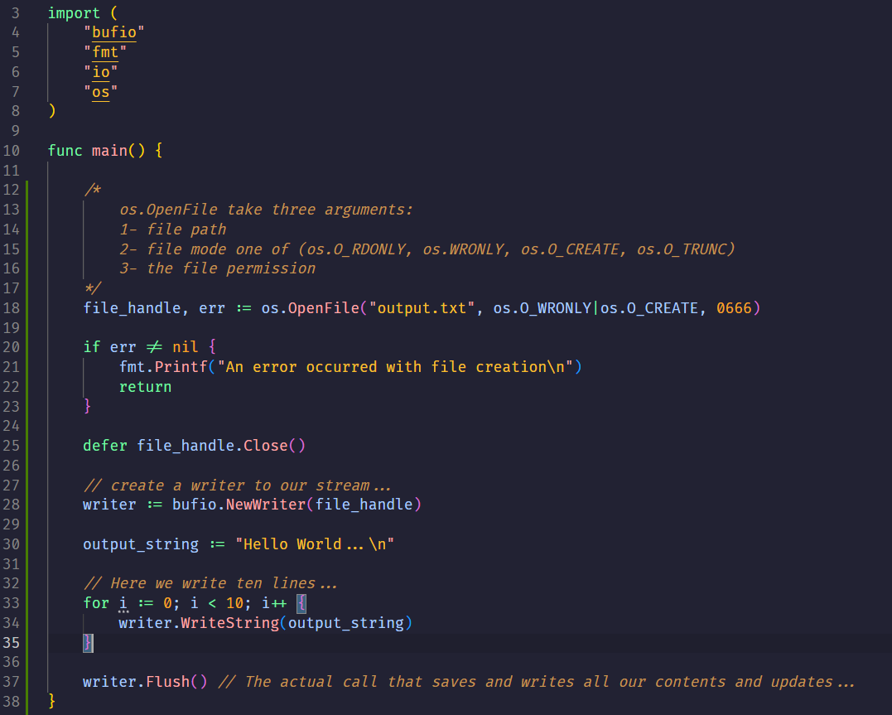
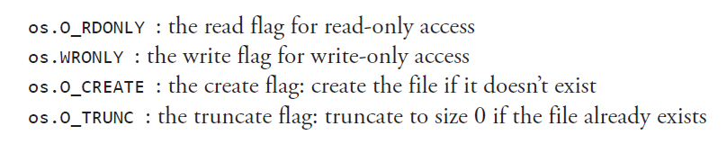


The Go Files (Writing in file):
When reading the file, permissions are ignored, allowing us to use a value of 0. When writing, we use the standard Unix file permissions of 0666 (even on Windows).
Don’t Forget

Slide 7
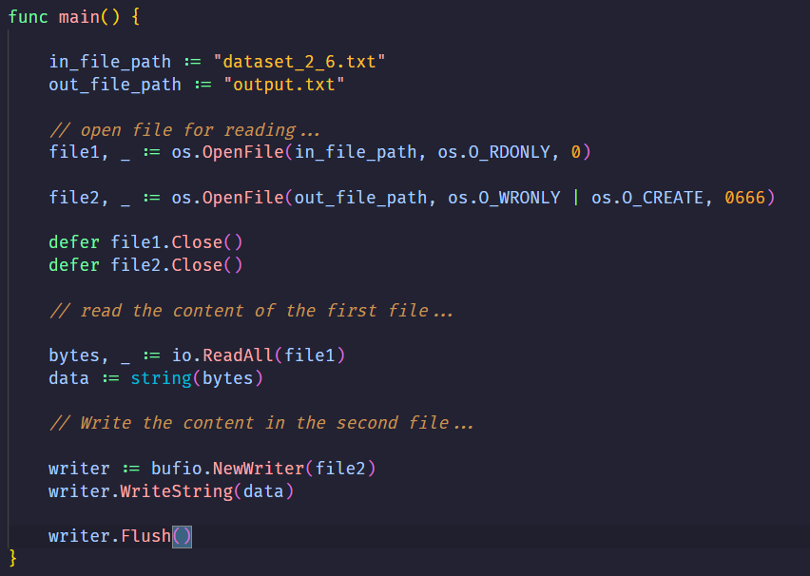
The Go Files (Writing in file):

Slide 8
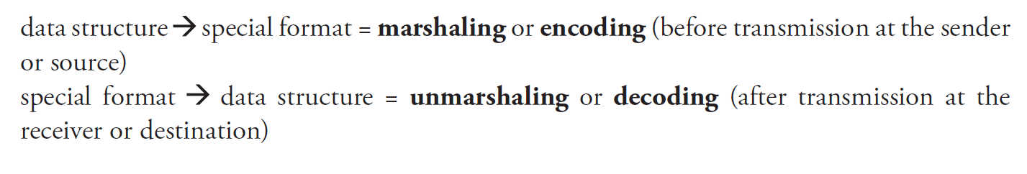
Marshaling & JSON
To transmit a data structure across a network or to store it in a file, it must be encoded and then decoded again; many encodings exist: JSON, XML, gob, Google’s protocol buffers, and others
Structs can contain binary data; if this were printed as text, it would not be readable for a human. Moreover, the data does not contain the name of the struct field, so we don’t know what the data means.
To remedy this, several formats have been devised, which transform the data into plain text, but annotated by their field names, so humans can read and understand the data
Data in these formats can be transmitted over a network: in this way, the data are platform independent and can be used as input/output in all kinds of applications, no matter what the programming language or the operating system is.
Encoding does the same thing, but the output is a stream of data
Marshaling is used to convert in-memory data to a special format (data -> string), and vice versa for unmarshaling (string -> data structure).
Decoding starts from a stream of data and populates a data structure.

Slide 9
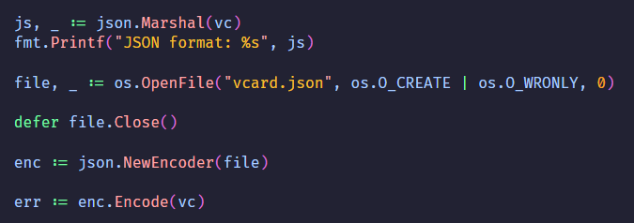
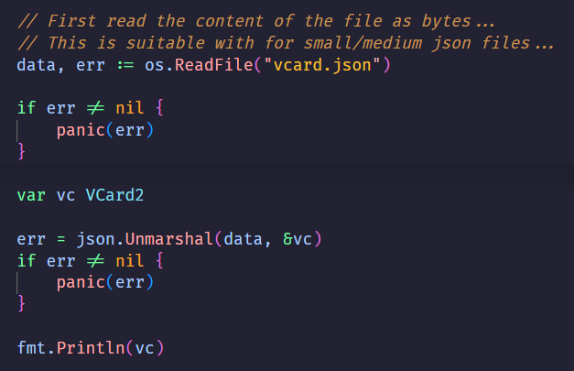
The Go Files (JSON):
Parsing JSON
Creating JSON
Create structs to store JSON data
Unmarshal JSON into structs
Create structs and populate with data
Marshal structs into JSON data
A populated object from a struct

Slide 10
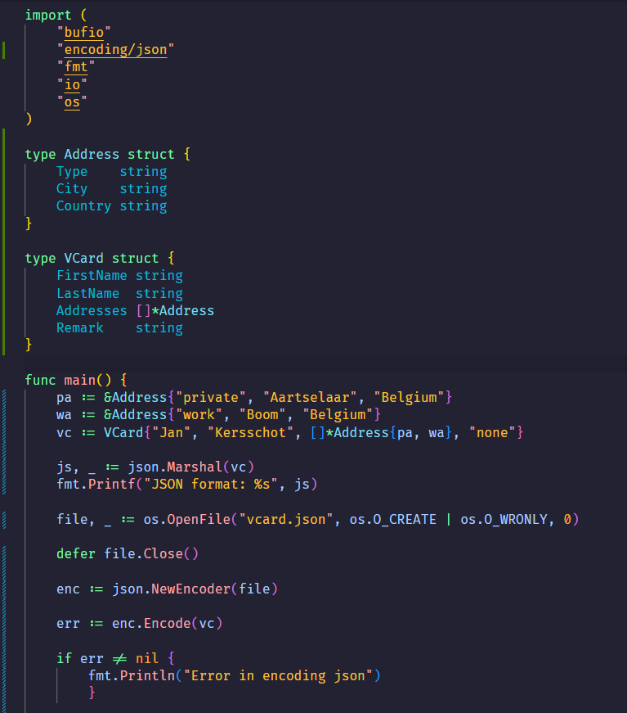
The Go Files (Marshal JSON):

Slide 11
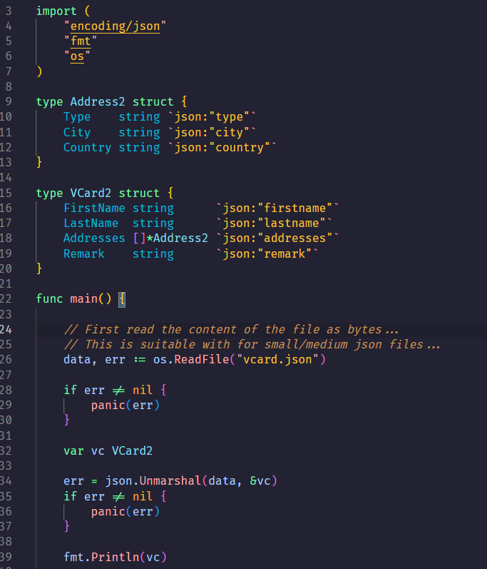
The Go Files (UnMarshal JSON):

Slide 12

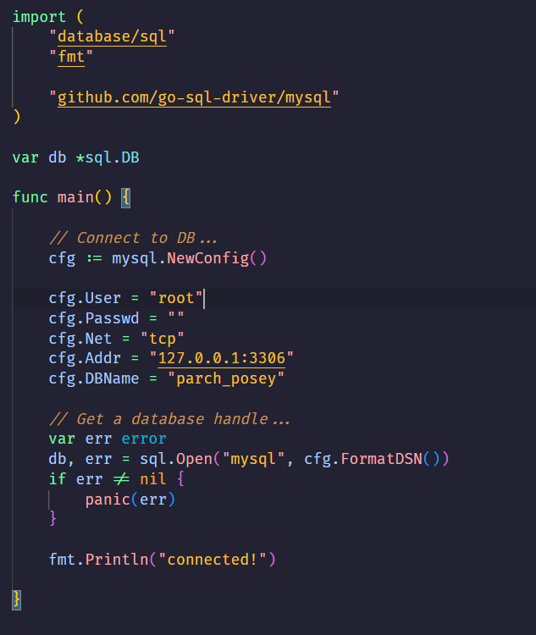
Go & mySQL (Configuration):
Database handle that will be used in every SQL statement
Connection string

Slide 13
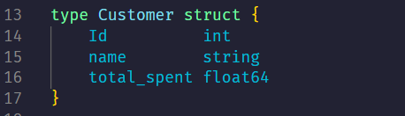
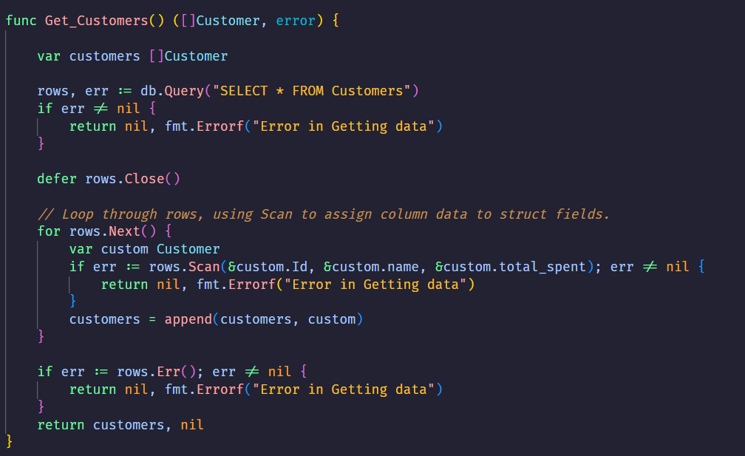
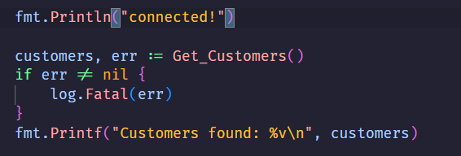
Go & mySQL (SELECT Statement):
First, you have to create a struct that has elements corresponding to the table fields you want
Query multiple data
Works like throwing exceptions
Make sure of the order of the fields and don’t forget the &
Calling in main

Slide 14
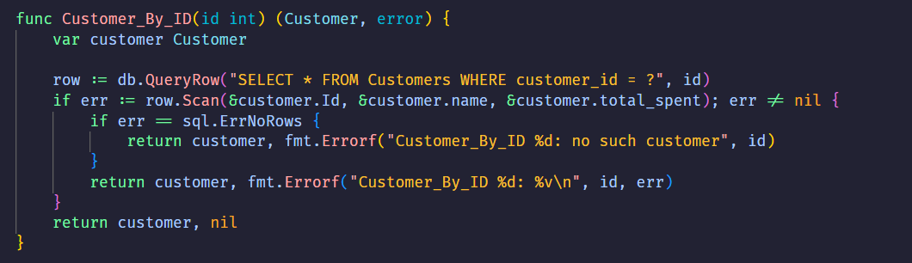
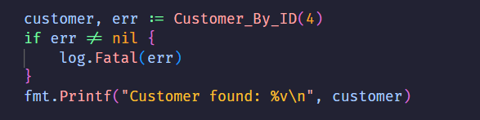
Go & mySQL (SELECT Statement):
First, you have to create a struct that has elements corresponding to the table fields you want
Query One Row
Calling in main

Slide 15
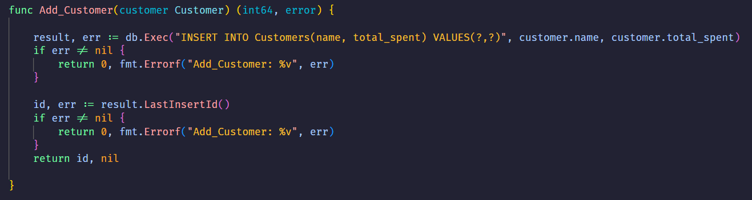
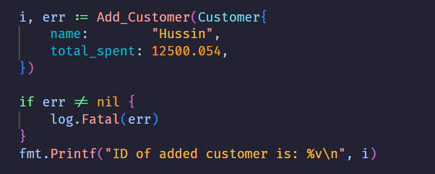
Go & mySQL (Add Data):
First, you have to create a struct that has elements corresponding to the table fields you want
Calling in main
DELETE & UPDATE statements work the same as INSERT statements using db.Exec()

Slide 16
Go Packages:
Packages only really make sense in the context of a separate program that uses them.
First, create a folder in which packages will be located, then in the terminal run go mod init <any_name>/folder_name [This will be the path any package import starts with]
Create a folder for each package. Each script in the package folder should start with <package folder_name>
In the main folder where you run <go mod init> place your main.go file, then import your package.

Slide 17
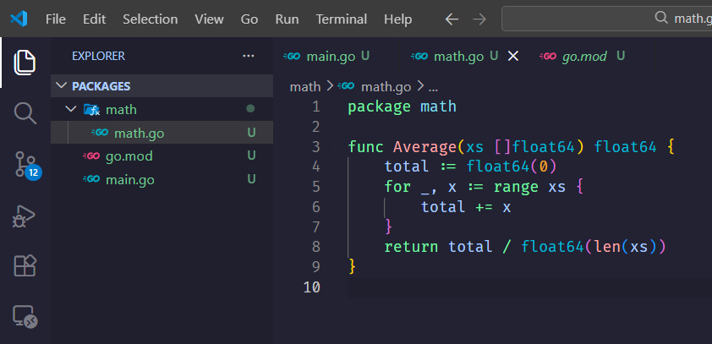
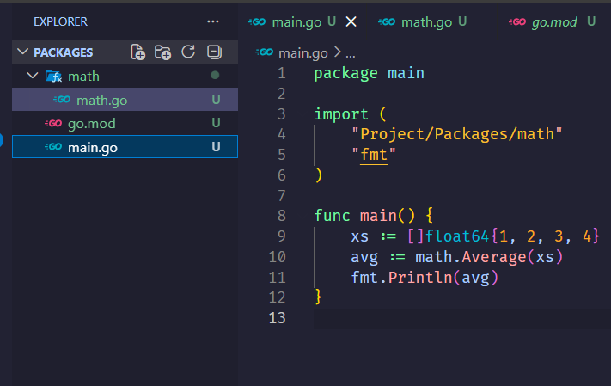
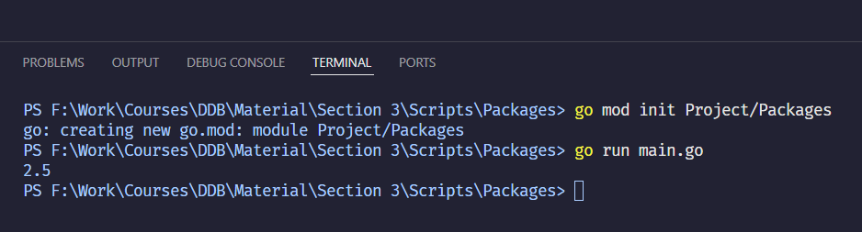
Go Packages:

Slide 18
Section Record:
https://drive.google.com/file/d/15wt33h9WPW5K0DWiGRJRU9CTi104BpwS/view?usp=sharing

